Slide 1
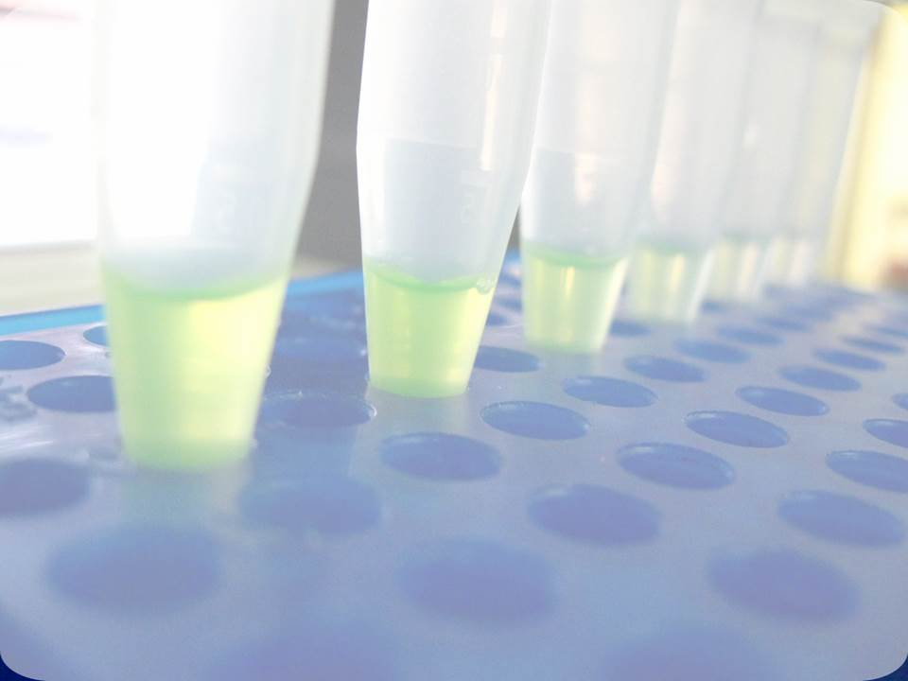

Activity planning according to Work Packages I-VII

Slide 2




WP1
RECRUITMENT
Maja Herak Bosnar
Maja.Herak.Bosnar@irb.hr

Slide 3
Objectives
Enhance the knowledge and know-how of RBI by hiring experienced researchers
Strengthen human resources in areas that are inadequately covered by the present RBI staff

Slide 4
Tasks
Advertise job vacancies at the national and international level
Official Gazzete of the Republic of Croatia and Croatian Employment Service, Euraxess Job portal, Nature Jobs, Spectrum der Wissenschaft, Scientific American
Form an evaluatian comittee (track record, research skills, experience)
Goal: chose the best possible candidate!
Employment 7 experienced researchers
3 technical asistants

Slide 5
Experienced researcher
Implement the new equipment
Enhence the RBI knowledge and know-how in array technology, bioinformatics, bioimaging, protein interactions, etc. and disseminate this knowledge to diploma and PhD students, premanent staff and users of the new equipment
Engage in workshops
Disseminate scientific information and facilitate communication between research entities

Slide 6
Employment issues should be solved in the first 6 months
The initial contract will cover the first 12 months – extension up to 30-34 months
Benefits according to Croatian legislation
Current status of the WP1
The job vacancies are already advertised

Slide 7
WP2
EXCHANGE & SECONDMENTS
Marijeta Kralj
Marijeta.Kralj@irb.hr

Slide 8
Objectives
Strengthen the existing research potential of RBI
Help to strengthen the S&T capacities of RBI researchers to successfully participate in research activities at Community level and the FP7 programme and beyond (Horizon 2020)

Slide 9
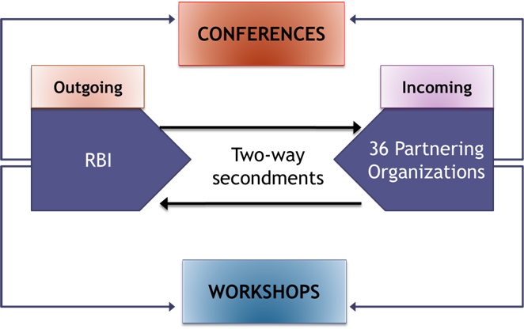
Description of work and tasks
To implement exchange of know-how through close interaction with knowledgeable and experienced partnering organizations
To organize trans-national two-way secondments (outgoing/incoming) involving 40 RBI researchers and 36 partnering organizations
The cooperation is based on a mutual benefit approach

Slide 10
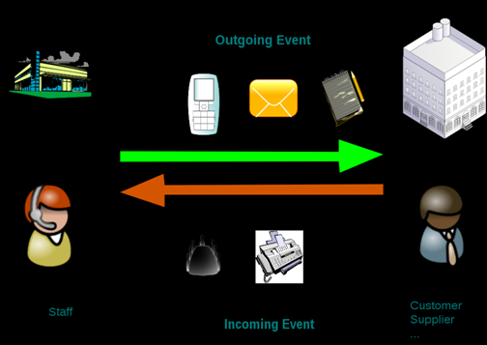
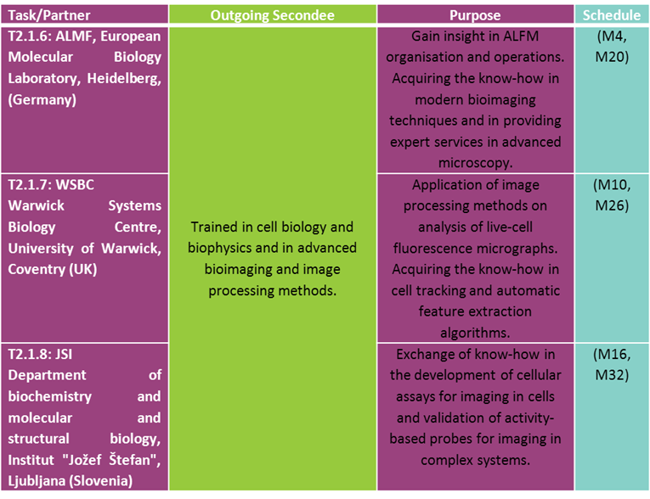
Outgoing secondments
  Up to 3 months
  The project budget covers daily allowances, travel, accomodation
  40 RBI scientists
  54 tasks
  Altogether 111 months

Slide 11
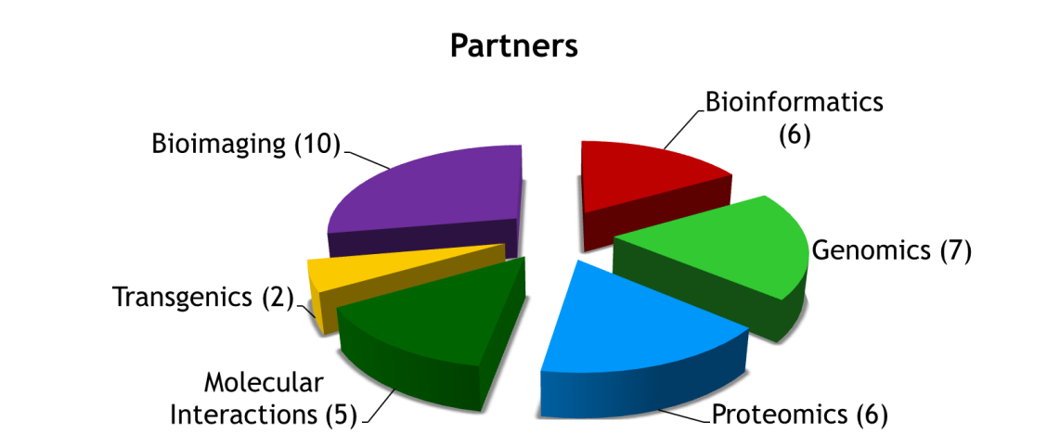
Incoming secondments
  Workshop lectures (lecture topics in WP5)
  Round table discussions/ practical work and demonstration of specific applications
  Incoming secondees will provide a PDF document containing the presentation shown at workshops/seminars/lectures
Visits are limited to periods of 5 days, maximum 3 visits

Slide 12
Tasks
Reports on secondment visits (outgoing/incoming) – month 18/36
  A standard laboratory manual documentation
  Report to identify the level of success of secondment and note any lessons learned for future secondments
Secondment Reports - Post Implementation Review
  Evaluation on whether the concerned activities contribute to the Research Potential increase of RBI and the necessary measures to be taken in order to preserve the sustainability of the implemented actions or benefits

Slide 13
WP3
Equipment Implementation & Exploitation
Ivo Piantanida
Ivo.Piantanida@irb.hr
Objectives
Fill the gaps in the bio-oriented research instrumentation pipeline of RBI by new equipment
Upgrade of the existing capacities of RBI bio-oriented research

Slide 14
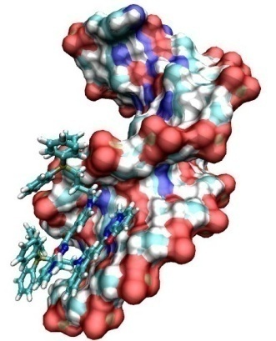
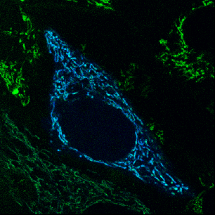
Bio-organic chemistry
(Piantanida, Jerić, Roje, Smith)
Structural characterisation of biomacromolecules (DNA/RNA/proteins)
Fluorescent markers, bioactive small molecules targeting biomolecules
NEW equipment: set of microcalorimeters (nanoDSC, ITC), viscometer
UPGRADES: flow oriented linear dichroism (LD) on CD/ORD Jasco J815
EXISTING: UV/vis (+thermal denaturation), fluorimeters, NMR, IR, set of MS instruments, gel electrophoresis, ...

Slide 15
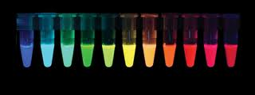

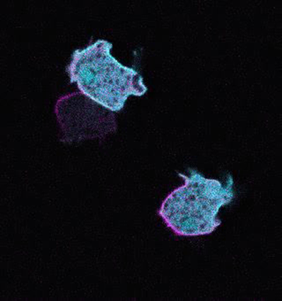
BIOIMAGING – EQUIPMENT
Confocal Microscopy
(Weber)
present state: Leica TCS SP2 AOBS (2003)
UPGRADE: versatile, flexible & expandable
main applications:
MICROSPECTROFLUORIMETRY IN SITU
ADVANCED FLUORESCENCE-BASED METHODS
LIVE CELL IMAGING

Slide 16

BIOIMAGING – EQUIPMENT
Confocal Microscopy
requirements:
  continuous excitation range
  spectral detection
  fast scanning
  improved sensitivity
  automatic focus control
  supression of reflection from glass
  FLIM capability
  high-content screening
  incubation chamber
  image-processing software
  extendable to superresolution

Slide 17
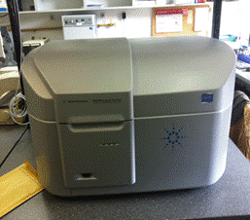
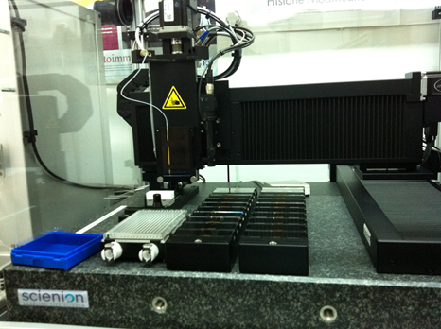
Genomics, Proteomics
NEW: Third generation DNA sequencer (Vugrek)
Upgrade: for RBI microarray platform
present state:
Upgrade: nanoUPLC for MALDI TOF facility /proteomics (Cindrić)
Molecular modelling upgrades (hardware, software) (Šmuc, Smith)
set of equipment for preparation of biological samples
High resolution microarray scanner Microarray spotter robot

Slide 18
Beyond InnoMol
In vivo imaging
At RBI : Small Animal Positron Emission Tomography (PET) and PET probes production (dr. A. Švarc)
At Croatian Institute for Brain Research (Zagreb, Prof. S. Gajović) REGPOT Project „GLOWBRAIN” (2012-15): MRI and fluorescence imaging (bioluminiscence, fluorescent probes) of small animals
Other resources:
Faculty of Pharmacy, Faculty of Science (Zagreb, Prof. G. Lauc) REGPOT project ”Integra-Life” (2013-16): (glycoproteomics, epigenetics, genetic engineering, biochemistry and bioinformatics)

Slide 19
WP4
IPR Management
Marin Roje
Marin.Roje@irb.hr

Slide 20
Objectives
To develop the plan for IP management
To integrate InnoMol scientific output to the knowledge database of RBI

Slide 21
Tasks
Strengthening support to knowledge transfer at RBI and support to commercialisation of intellectual property (IP) at RBI by
Development of IP management plan
Training in the area of IP
Presenting research and innovation capacity to business community/end-users
Creating knowledge database at RBI

Slide 22
Potential specific areas from which IP is suspected to arise:
-Microarrays (DNA and protein)
-Bioimaging
-Spectroscopy (as a tool in novel diagnostic methods)
-Bioinformatics
-Organic synthesis (new bioactive chemical entities)
The IP management plan will deal with the following topics:
-Protect the know-how by submission of a patent application
-Look for competitive researchers, collaborations partners, etc.
-Compose a business plan with a defined business model
-Search for potential investors and or a strategic alliance
-Speed up the pro-active search for a licensing partner

Slide 23

Development of IP management plan
WP4 Activites
Creation of knowledge database at RBI
InnoMol/RBI web
Info-days for targeted industry/business sector, printed reports, website, e-newsletters, brochure, 2 investors’ forums
Training in the area of IP
Presentation of research and innovation capacity to business community
Mapping and screening results collected in co-operation with representatives of all participants in the project

Slide 24
WP5
DISSEMINATION & VISIBILITY ACTIVITIES
Ivanka Jerić
Ivanka.Jeric@irb.hr

Slide 25
Objectives
Increase visibility of RBI – Centre of excellence in Molecular Biosciences in SEE
Disseminate InnoMol objectives and results
Demonstrate capabilities of new research pipeline
Stimulate networking and realization of synergies with other European initiatives related to InnoMol

Slide 26
Tasks
To disseminate knowledge and know-how
To ensure effective flow of information and publicity
To emphasize the contributions made to European scientific excellence, the value of collaboration on a Europe scale, and the benefits to EU citizens

Slide 27
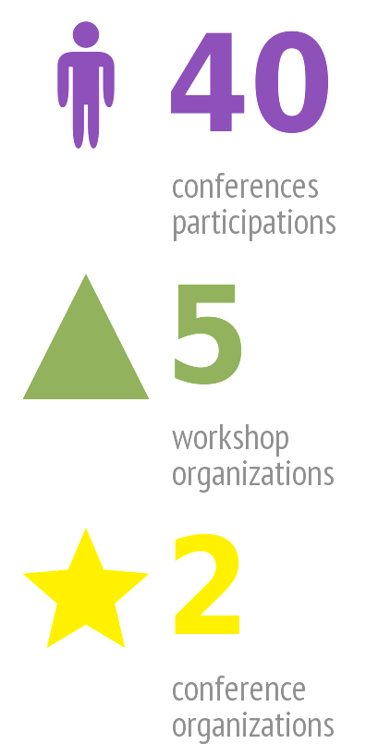
Participation of RBI staff at Conferences
Genomics& Bioinformatics Proteomics Bio-Imaging Molecular Interactions New Platform for Molecular Solutions in Research and Development
Multinational Congress on Microscopy, 2015 International Congress on Epigenomics, 2016

Slide 28
A typical workshop configuration
Time-plan | 1st Day | 2nd Day | 3rd Day
9.00 | Application background | Sample preparation | Practical work and tutorial
 | Introduction to Instruments/ Methods | Practical work and tutorial | Data analysis and interpretation
 | Experimental design | Practical work and tutorial/Round table discussion | Discussion
17.00 | Discussion | Discussion | Social gathering
18.00 | Sponsors/ Presentations

Slide 29
A timing chart of workshop and conference activities
 | Project months
 | 2 | 4 | 6 | 8 | 10 | 12 | 14 | 16 | 18 | 20 | 22 | 24 | 26 | 28 | 30 | 32 | 34 | 36
Workshop 1
Workshop 2
Workshop 3
Workshop 4
Workshop 5
Conference 1
Conference 2

Slide 30
WP6
MANAGEMENT
David M. Smith
David.Smith@irb.hr

Slide 31
Objectives
Smooth implementation of the InnoMol project
Stimulate the realization of the full research potential of RBI
by unlocking and developing emerging excellence in the
Molecular Biosciences

Slide 32
Tasks
Project Management (Administrative, Financial, …)
Design of Project handbook
Hiring of Administrative assistant
Progress Reports and Final Report
Coordinate Steering Committee and Advisory Board
Ethical management issues

Slide 33
Steering Committee (SC)
Target the sustainability of the Action Plan and the Research
Agenda (beyond the project's lifetime).
Consisting of experts from partnering organizations and
relevant domestic bodies (research, business, government)
Exact make-up to be finalized by month 6
Interactions with the SC members will primarily take place
during the workshops (WP5) and exchange visits (WP2)
Yearly Reports (Conclusions)
Interaction with the Advisory board (month 24 and ex-post)

Slide 34
Advisory Board (AB)
Assist in decision-making regarding Intellectual Property
Rights (IPR) and exploitation issues
Consisting of domestic and international experts with
experience in IPR.
Exact make-up to be finalized by month 6
Individual consultation as required
Interaction with the SC (Month 24 and ex-post)

Slide 35
WP7
EX-POST EVALUATION
Miroslav Plohl
Miroslav.Plohl@irb.hr

Slide 36
Objectives
Provide efficient interface between InnoMol, independent experts and regional authorities
Stimulate the uptake of recommendations of independent evaluators for preserving emerging excellence for the Molecular Biosciences
The task of this WP is to apply for an international independent expert evaluation
- to organise round table meeting with experts, steering committee members and policy makers and representatives of the national research ministry and regional authorities.
No activities planned until M37

